Slide 1
Agenda What is Containerization? What is Docker? Docker Architecture and Workflow Why we need to use Docker? Where it will fit in SDLC?

Slide 2
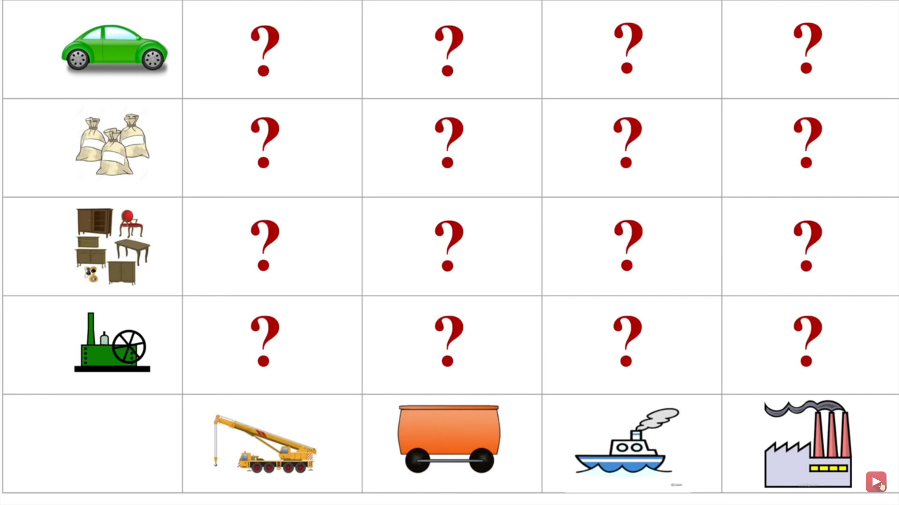
Classic problem in Shipping Industry

Slide 3
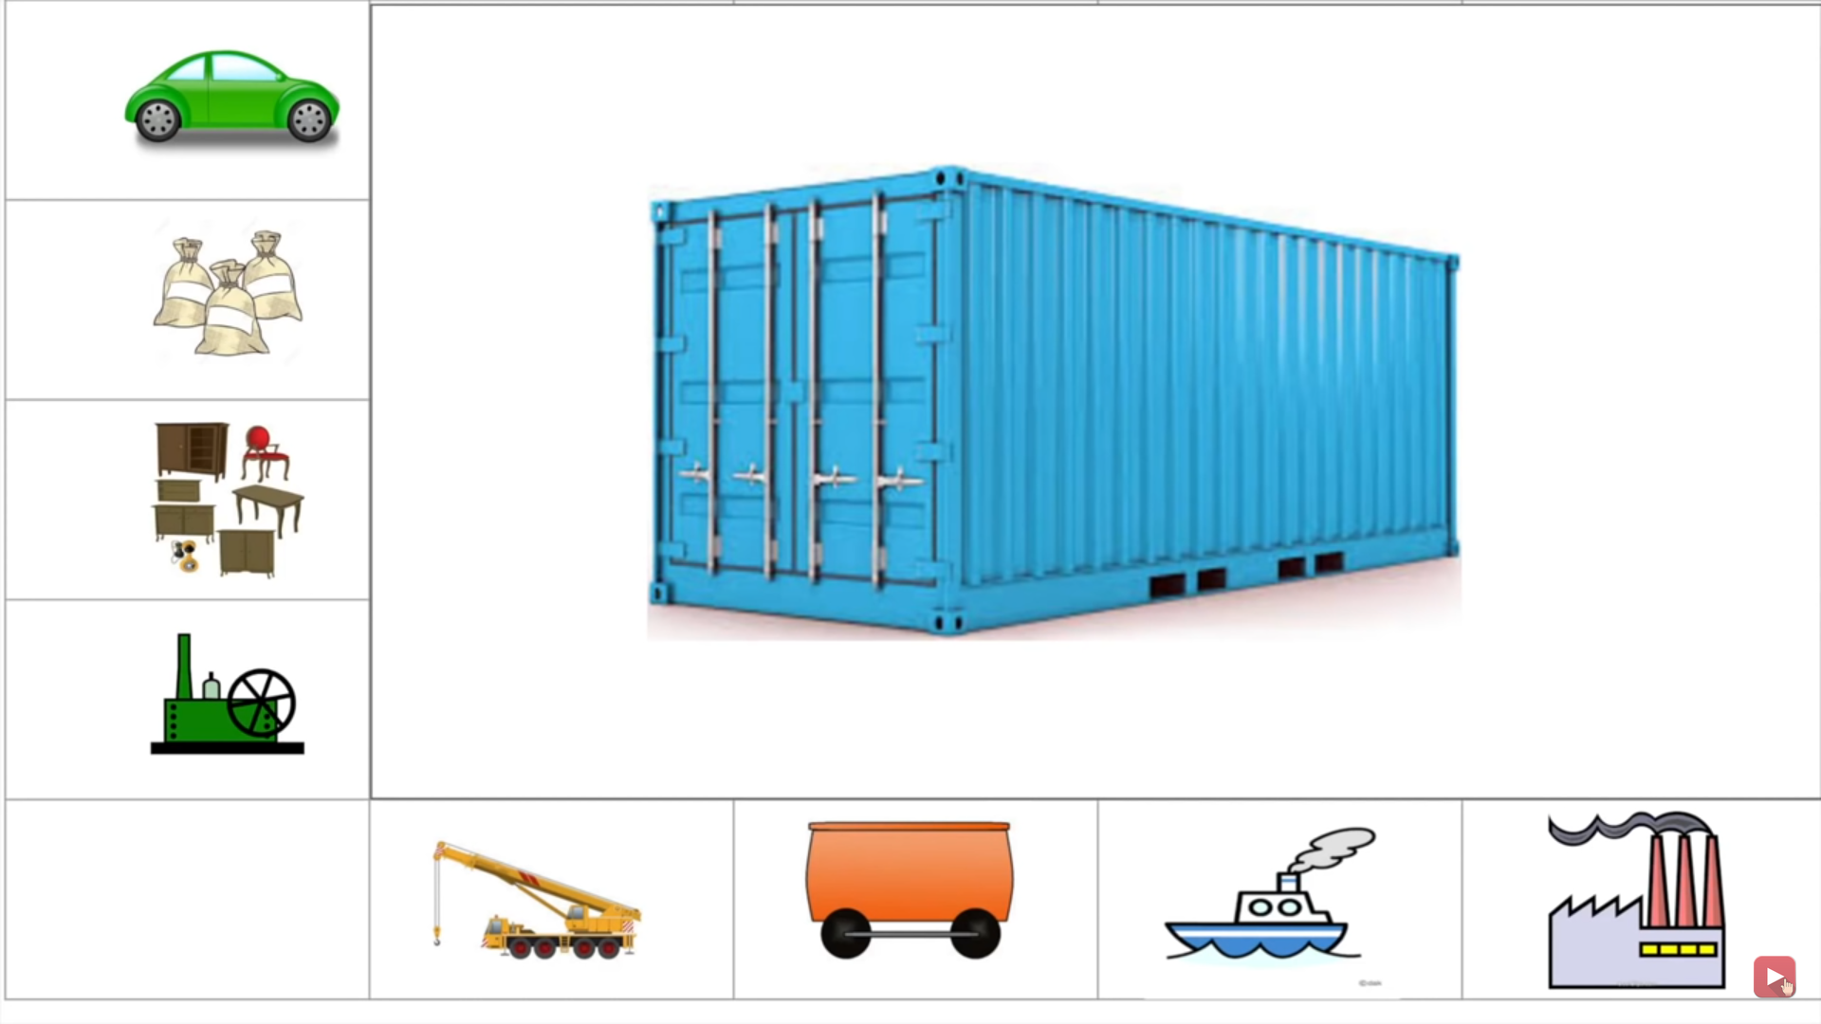

Slide 4
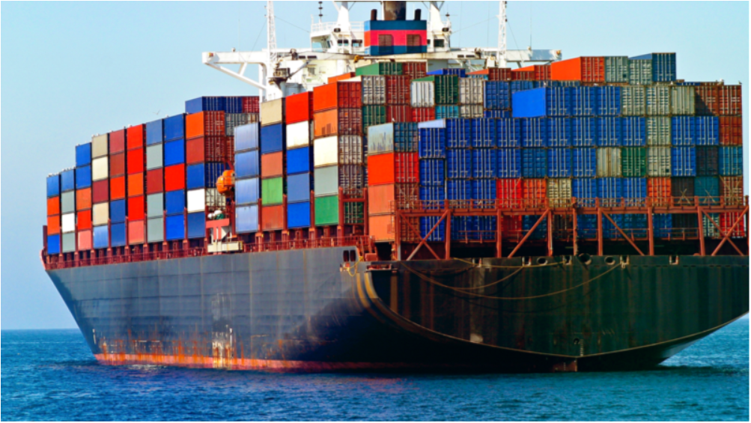
Containerization

Slide 5
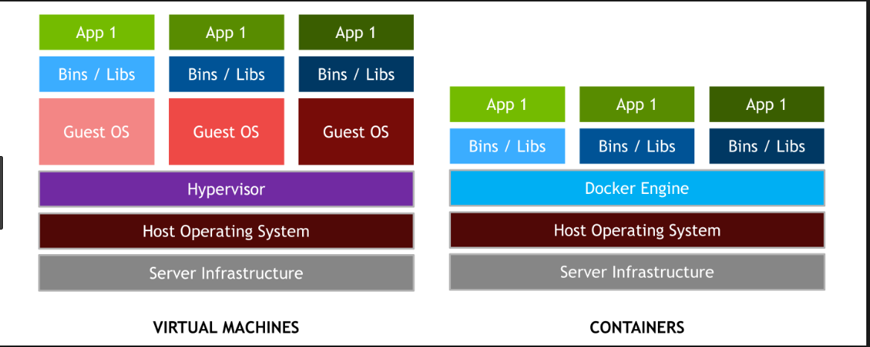

Slide 6
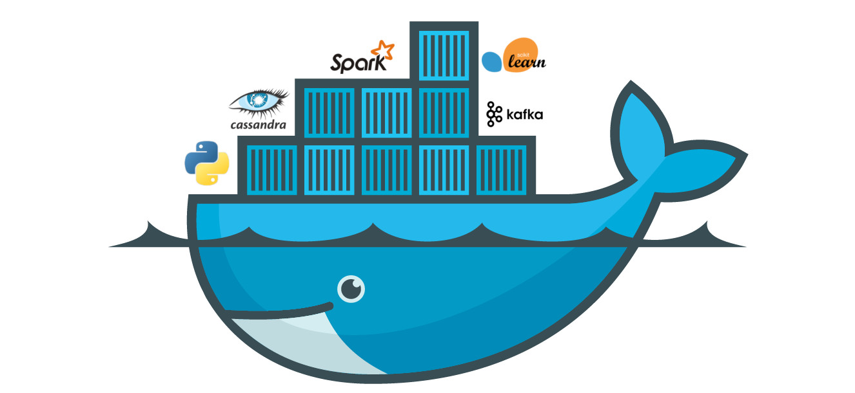
Docker
Docker is the world’s leading software container platform
Docker is a tool for Building, shipping and running distributed applications

Slide 7
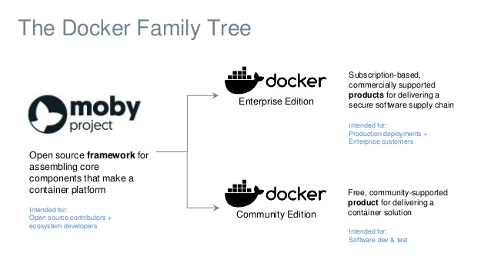

Slide 8
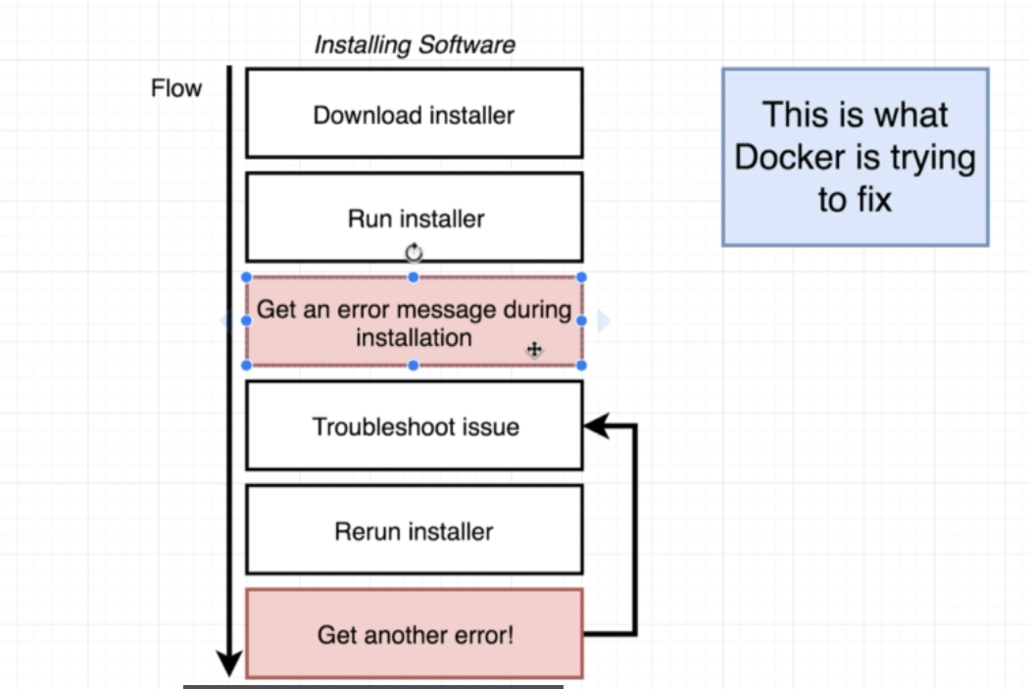

Slide 9
Quick Context
Docker is an open-source project that automates the deployment of S/W applications inside containers by providing an additional layer of abstraction and automation of OS-level Virtualization on Linux.
Docker makes the process of application deployment very easy in a sandbox called containers to run on the host OS i.e. Linux and efficient and resolves a lot of issues related to deploying applications.
The Key benefit of Docker is that it allows user to package an application with all its dependencies in to standard unit for S/W development unlike VM, containers do not have high overhead hence enable more efficient usage of underlying system and recources.
Docker gives you a standard way of packaging your application with all its dependencies in a container
Build app only once and run anywhere.
No worries that the application will not perform the same way it did on testing environment or dev env.

Slide 10
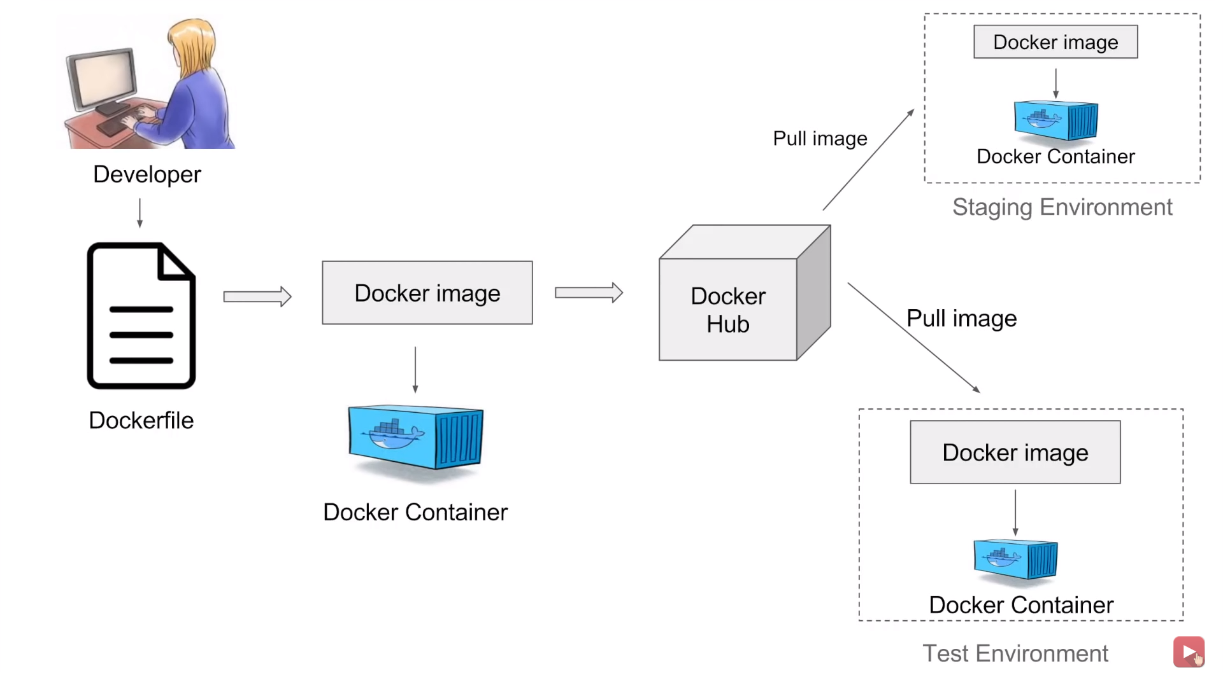

Slide 11


Slide 12
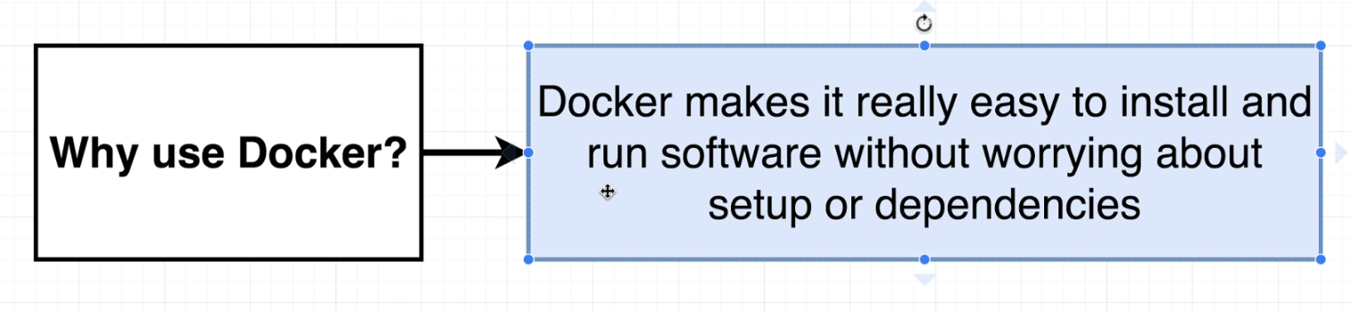

Why Docker

Slide 13
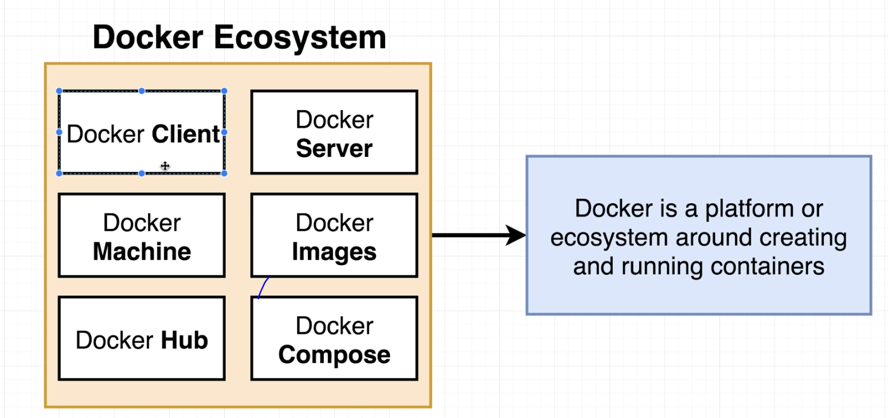
Docker Ecosystem

Slide 14
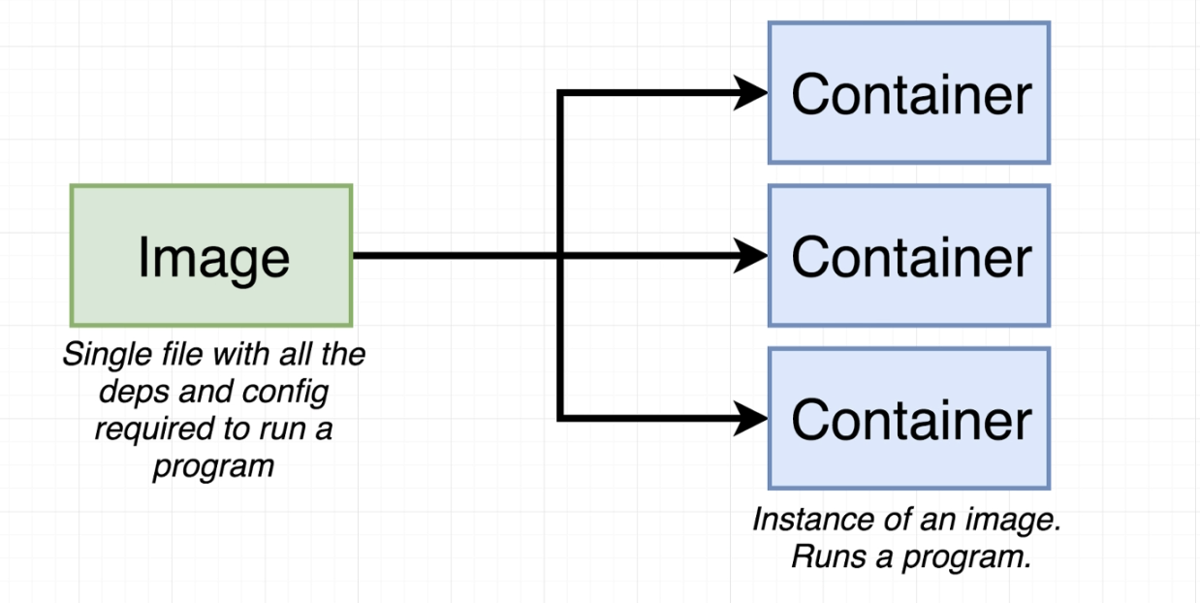

Slide 15
Use docker command to search for nginx image
docker search nginx
Use docker command to download the nginx image
docker pull nginx
Use docker command to list all images on the instance
docker images
Use docker command to list all running & stopped containers
docker ps
docker ps –a
Use docker command to remove an image
docker rmi nginx
Use docker command to run the nginx image, also map port 8080 of instance to port 80 of container
docker run -d -p 8080:80 nginx
Use docker command to connect to a running container
docker exec -ti nginx /bin/bash

Slide 16
OS Level Virtualization- aka Containerization
Tool to create, develop and deploy applications using Containers
Packaging an application including the Runtime Environment
Docker Terminologies:
Dockerfile
Image
Container:
DockerHub: https://cloud.docker.com/
Docker-client
Docker-server
http://play-with-docker.com/

Slide 17
